Slide 1
The Dev Society
Name ideas
watchNow
ACTION
Picture palace…..
films4U
flashFilms
watchWonders
Picturesque…….
Cinematic
By Robyn Smith, Percival Ho, Lilith Miller-Fermor, Oliver Cray and Michael Okikiade

Slide 2
https://codepen.io/mandymichael/pen/aJLYVz

Slide 3
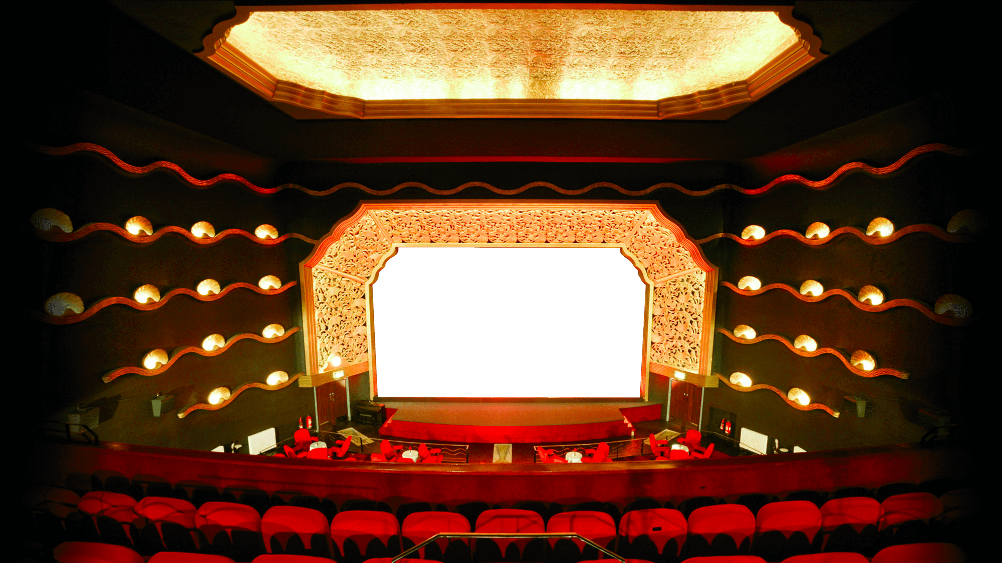
Initial user story
User Story
As a user I want to be able to search for my favourite films and films I haven’t seen yet to find out more information about them and add them to my watch list. So that I can store my watch list and remember which films I would like to watch next.
Acceptance criteria
When I search for a film
Then I am provided with an image of the film poster, the trailer, name, cast and plot of the film
When I press a button
Then the film saves to my watch list
When I view my watchlist
Then I am presented with the names of all the films I have saved
When I have watched a film
Then I am able to tick off (checklist)/ remove this from my watch list
When I look at the website from multiple devices
Then I am presented with a responsive website that looks good on all devices

Slide 4
Update to user story
As a user I would like to see where my favourite films were made and the OMBD rating of the film
Update to acceptance criteria
When I search the film
Then I see the location of the film on a map
When I search the film
Then I see the rating of the film
When I open the application
Then I am presented with

Slide 5
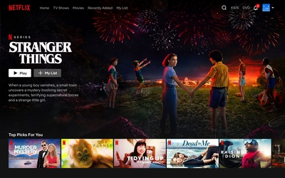





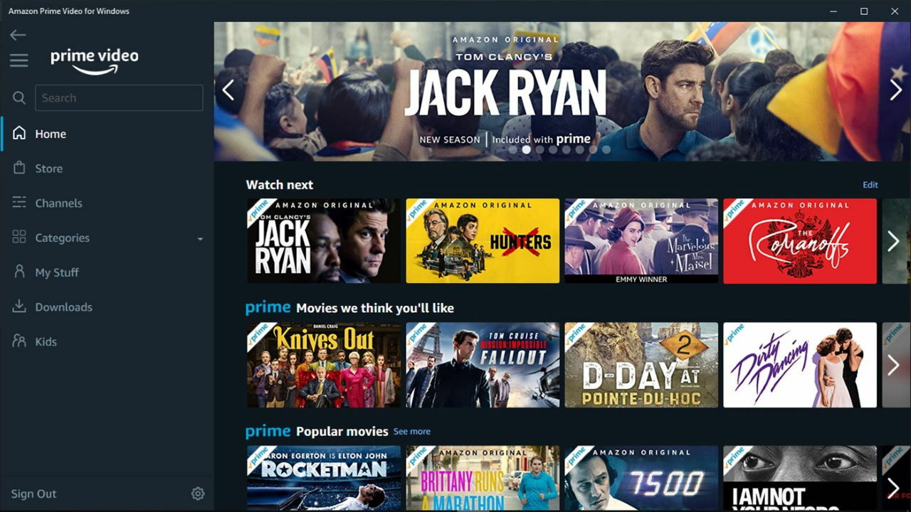
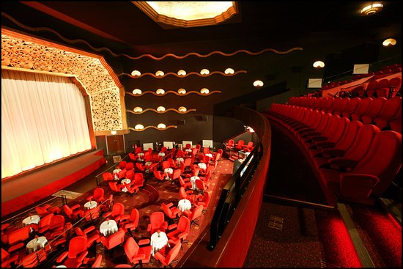

Target Audience
Who is the target audience?
People who enjoy films
people who go to the cinema,
People who use streaming sites
Why have we chosen this design?
We have chosen a cinematic art deco theme and font to link with the target audience
We have chosen dark mode, large picture banners to reflect the cinema experience and to mirror popular streaming sites such as Netflix, amazon prime, Disney plus
We researched cinema’s and streaming sites for inspiration when choosing colours, black, gold, red, blue, were popular choices and worked well with our branding

Slide 6
Issues faced..
The issues faced no access to rotton tomatoes api

